Slide 1
Communication is Everything
______________________________
Sheila Styron, ACTCP Disability Rights Advocate
August 10th, 2022

Slide 2
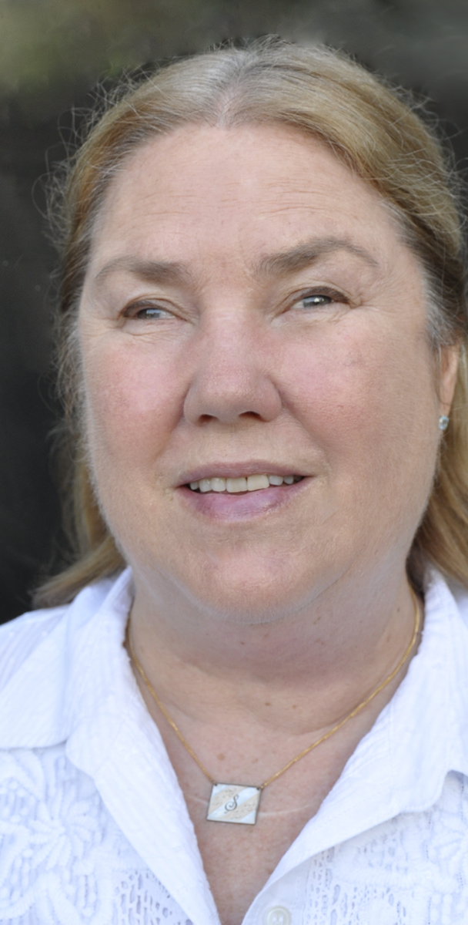
Sheila Styron, ACTCP Disability Rights Advocate
Sheila Styron works as a Disability Rights Advocate and Blindness Low Vision Specialist for The Whole Person in Kansas City. Not only is she the first person who is blind to have become certified as an ADA Coordinator and Trainer, but she has also served two terms as president of Guide Dog Users, Inc. and two terms as Board Chair of Learning Ally in Los Angeles. Sheila is a strong advocate for eliminating barriers for people living with disabilities. Because of her advocacy, Sheila promotes public transportation, has worked with the Department of Justice on its revised definition of service animals, participated in designing accessible tours for the Getty Museum in LA and the Nelson-Atkins Museum of Art in KC, and provides accessible outdoor experiences for people who are blind or have low vision.
Formerly a professional musician, Sheila enjoys playing the ukulele. She also enjoys doing yoga, cross-country skiing, and adventures like swimming with dolphins and skydiving!

Slide 3
Learning Objectives
______________________________________
To recognize that our human commonalities far outweigh the differences you may associate with having a disability.
To know how to avoid the pitfalls of making inadvertent assumptions about people with disabilities.
To understand how virtual, physical, and personal barriers encountered by this population effect their lives and relationships.
To see that appropriate communication and respect are the keys to successfully interacting with people with disabilities.

Slide 4
______________________________________
Mission: The Whole Person connects people with disabilities to the resources they need by supporting independent choice and advocating for positive change in the community.
Vision: The Whole Person envisions a fully accessible community where opportunities and choices are not limited by disability.
Core Values: Respect; Integrity; Inclusiveness; Commitment; and Collaboration.

Slide 5
Disability
______________________________________
Disability is a normal and inevitable part of the human experience.
The disability community is the only minority group that anyone can join at any time.
26% of the population (1 in 4 people) are living with a disability right now.

Slide 6
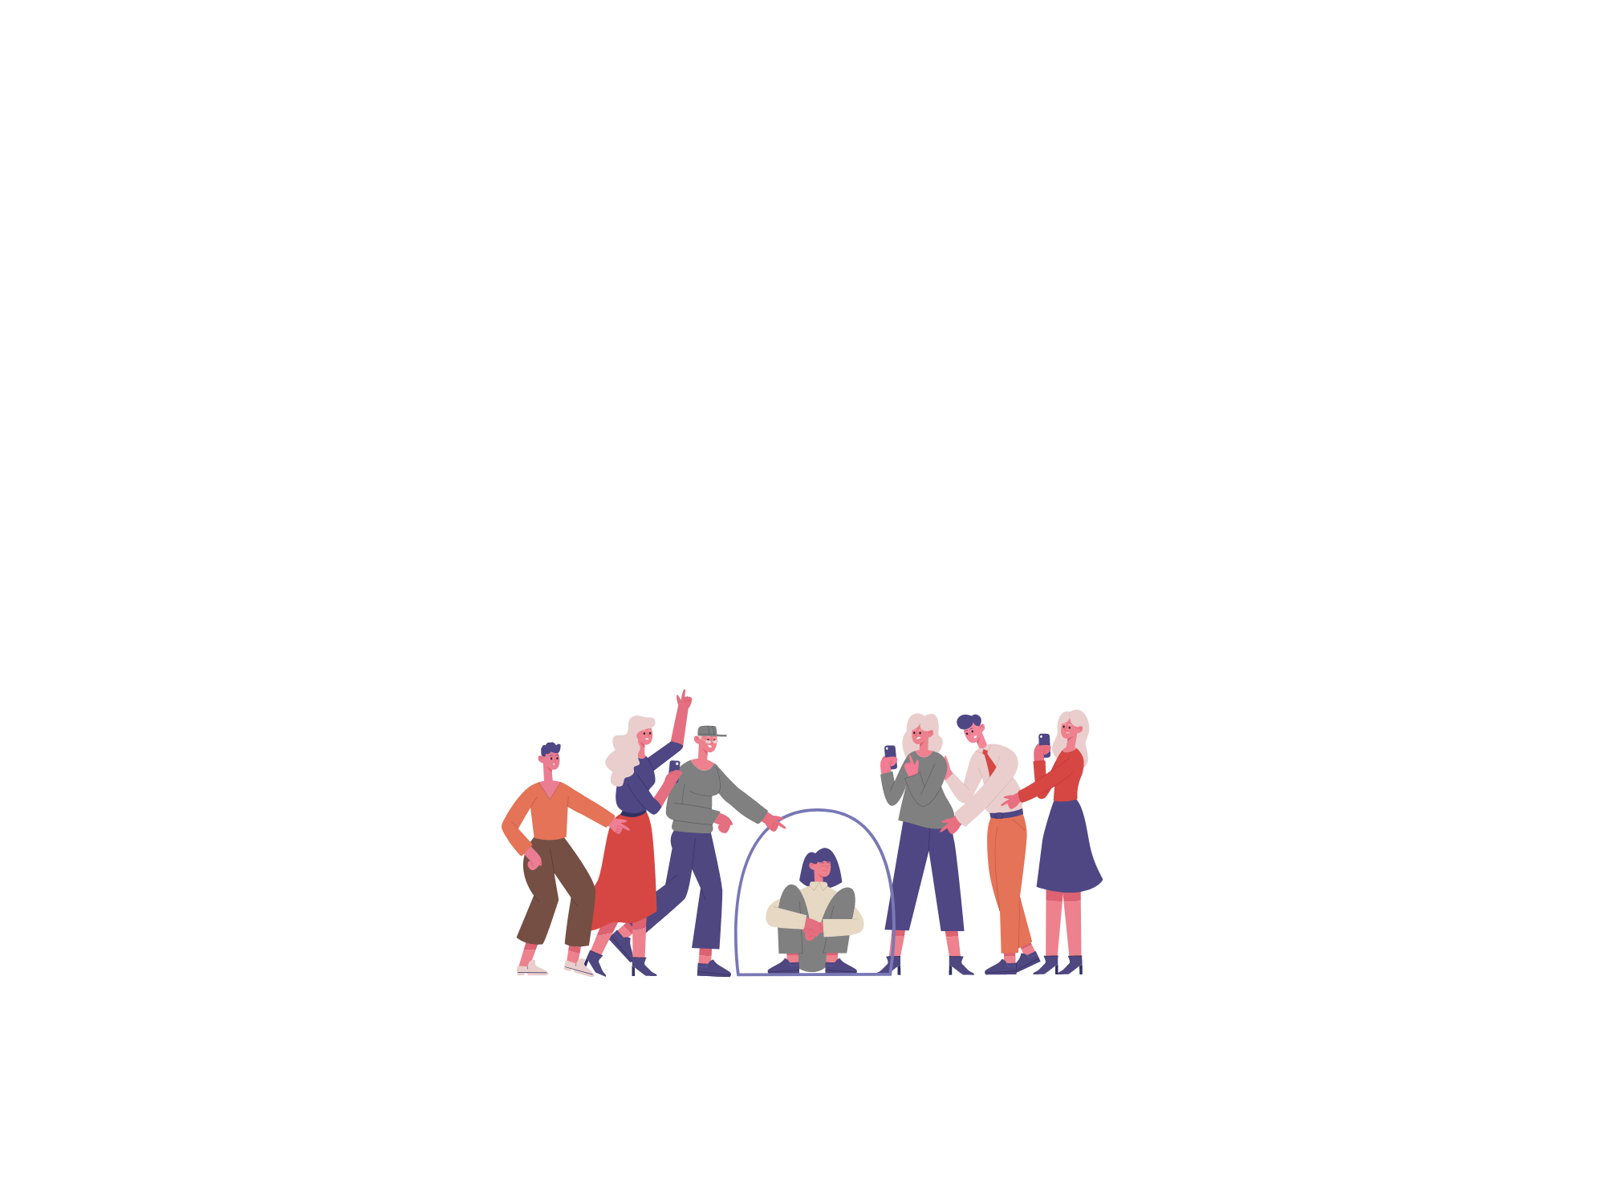
Ableism
______________________________________
Ableism is the discrimination of and social prejudice against people with disabilities.

Slide 7
Ableism
______________________________________
Ableism defines people by their disability.
The world wasn’t designed for people with disabilities; therefore, it is inherently ableist.
Like racism and sexism, ableism classifies entire groups of people as “less than.”
Ableism includes harmful stereotypes, misconceptions, and generalizations about people with disabilities.

Slide 8
Ableism
______________________________________
It is not easy to define ableism to make it a good fit for describing everyone’s experience with living with a disability.
People experiencing disability are as unique as everyone observing this presentation.
What may not be offensive to one person could be offensive or upsetting to someone else.
Ableism exists both personally and systemically. Personal ableism tends to evolves more quickly than systemic change.

Slide 9
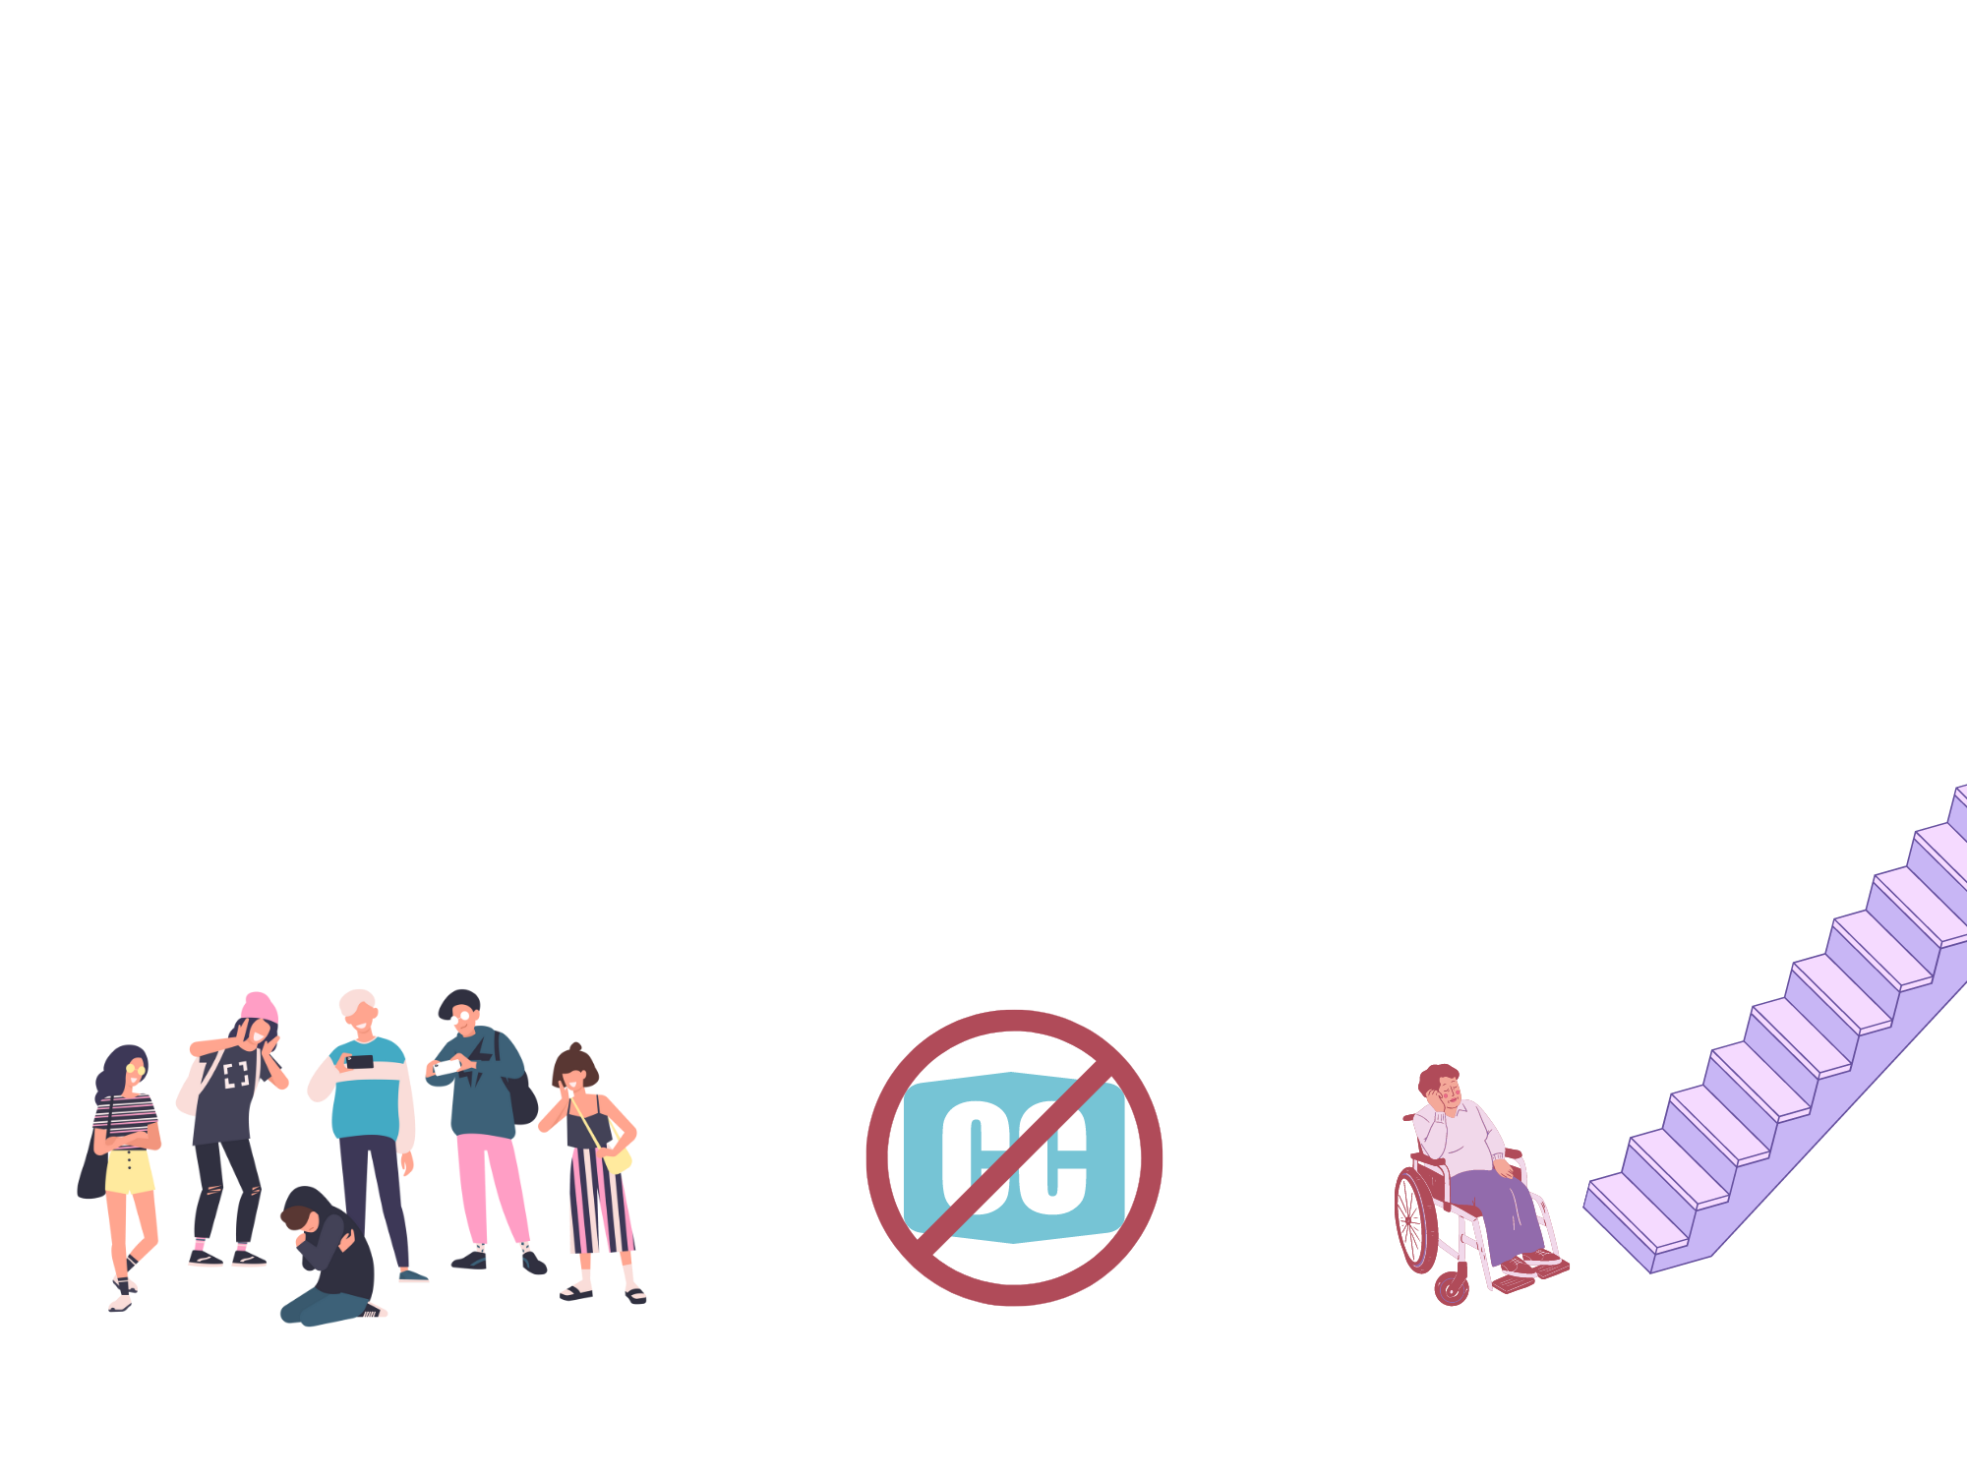
Ableism
______________________________________
Ableism can take the form of ideas and assumptions, stereotypes, attitudes and practices, physical barriers in the environment, or larger scale oppression. It is oftentimes unintentional, and most people are completely unaware of the impact of their words or actions.

Slide 10
Personal Ableism
______________________________________
Feeling instinctively uncomfortable around disabled people, or anyone who seems “strange” in ways that might be connected to a disability of some kind. Examples include:
Being nervous, clumsy, and awkward around people in wheelchairs
Being viscerally disgusted by people whose bodies appear to be different or “deformed.”
Avoiding interacting with disabled people out of fear or embarrassment.

Slide 11
Personal Ableism
______________________________________
Holding stereotypical views about disabled people in general, or about certain sub-groups of disabled people. For example:
Assuming that a disabled person’s personality can fit only into a few main categories (e.g., sad and pitiful, cheerful and innocent, bitter and complaining.)
Associating specific stereotypes with particular conditions. (e.g., people with Down Syndrome being happy and naïve, people with mental illness being unpredictable and dangerous, etc.)
Placing different disabilities in a hierarchy of “severity.”

Slide 12
Personal Ableism
______________________________________
Resenting disabled people for advantages or privileges that you think they have, such as:
Believing that ADA parking spaces, discounts, skipping lines, etc. are “unearned favors” and not necessities.
Thinking that unlike other minorities, disabled people are not oppressed, but coddled and pampered.
Jumping to conclusions that people with disabilities don’t have to work and get government benefits for life.

Slide 13
Personal Ableism
______________________________________
Choosing an inaccessible venue for a meeting or event.
Interacting with a service animal without permission.
Framing disability as either tragic or inspiring in media.
Casting a non-disabled actor to play a disabled character.
Parking in an accessible parking spot when you’re not disabled.
Assuming that a disability has to be visible.
Asking how someone became disabled.
Using disability as a punchline or mocking disability.
Talking to a disabled person like they’re a child.

Slide 14
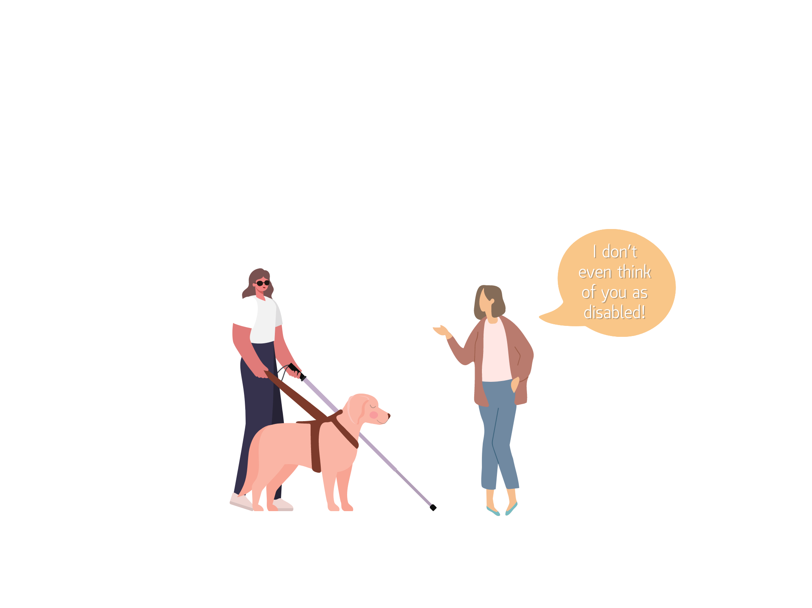
Micro-Aggressions
______________________________________
Micro-aggressions are everyday verbal or behavioral expressions that communicate a negative slight or insult in relation to someone’s gender identity, race, sex, disability, etc.

Slide 15
Micro-Aggressions

Slide 16
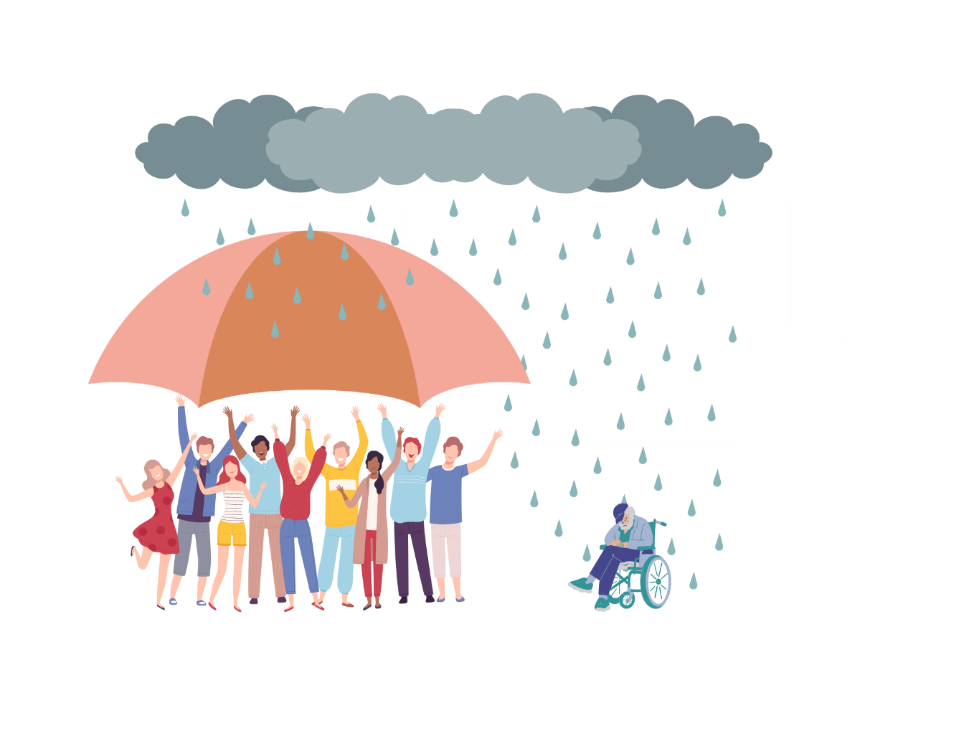
Systemic Ableism
______________________________________
Exclusion of people with disabilities when and where they are supposed to be protected by covered entities.

Slide 17
Systemic Ableism
______________________________________
Before Section 504 of the Rehabilitation Act, the Individuals with Disabilities Education Act, and the Americans with Disabilities Act, it was perfectly legal to simply exclude disabled people from government services and employment, going to public schools, and even enter businesses and buy goods and services.

Slide 18
Systemic Ableism
______________________________________
Some examples of systemic ableism are:
Establishments that fail to provide reasonable accommodations at work, education, and medical settings.
Segregating students with disabilities into separate schools.
Using restraint or seclusion to control people with disabilities.
Failing to incorporate accessibility into building design plans.
Creating inaccessible websites
Buildings without braille on signs, elevator buttons, etc.

Slide 19
Takeaways: DON’Ts
______________________________________
Touch a person with a disability or any of their equipment (including service animals) without consent.
Ask invasive questions.
Assume you know what someone with a disability needs.
Speak on behalf of someone with a disability unless they explicitly ask you to.

Slide 20
Takeaways: DOs
______________________________________
Believe people when they disclose a disability to you.
Listen to people when they request an accommodation.
Become familiar with people-first language and appropriate disability etiquette.
Talk about disability with children and young people.
Incorporate accessibility into your event planning.

Slide 21
Takeaways
______________________________________
Make sure people with disabilities are at the table where decisions are being made which will affect their work and community lives. It is much easier to build in accessibility from the outset than to go back and make fixes.

Slide 22
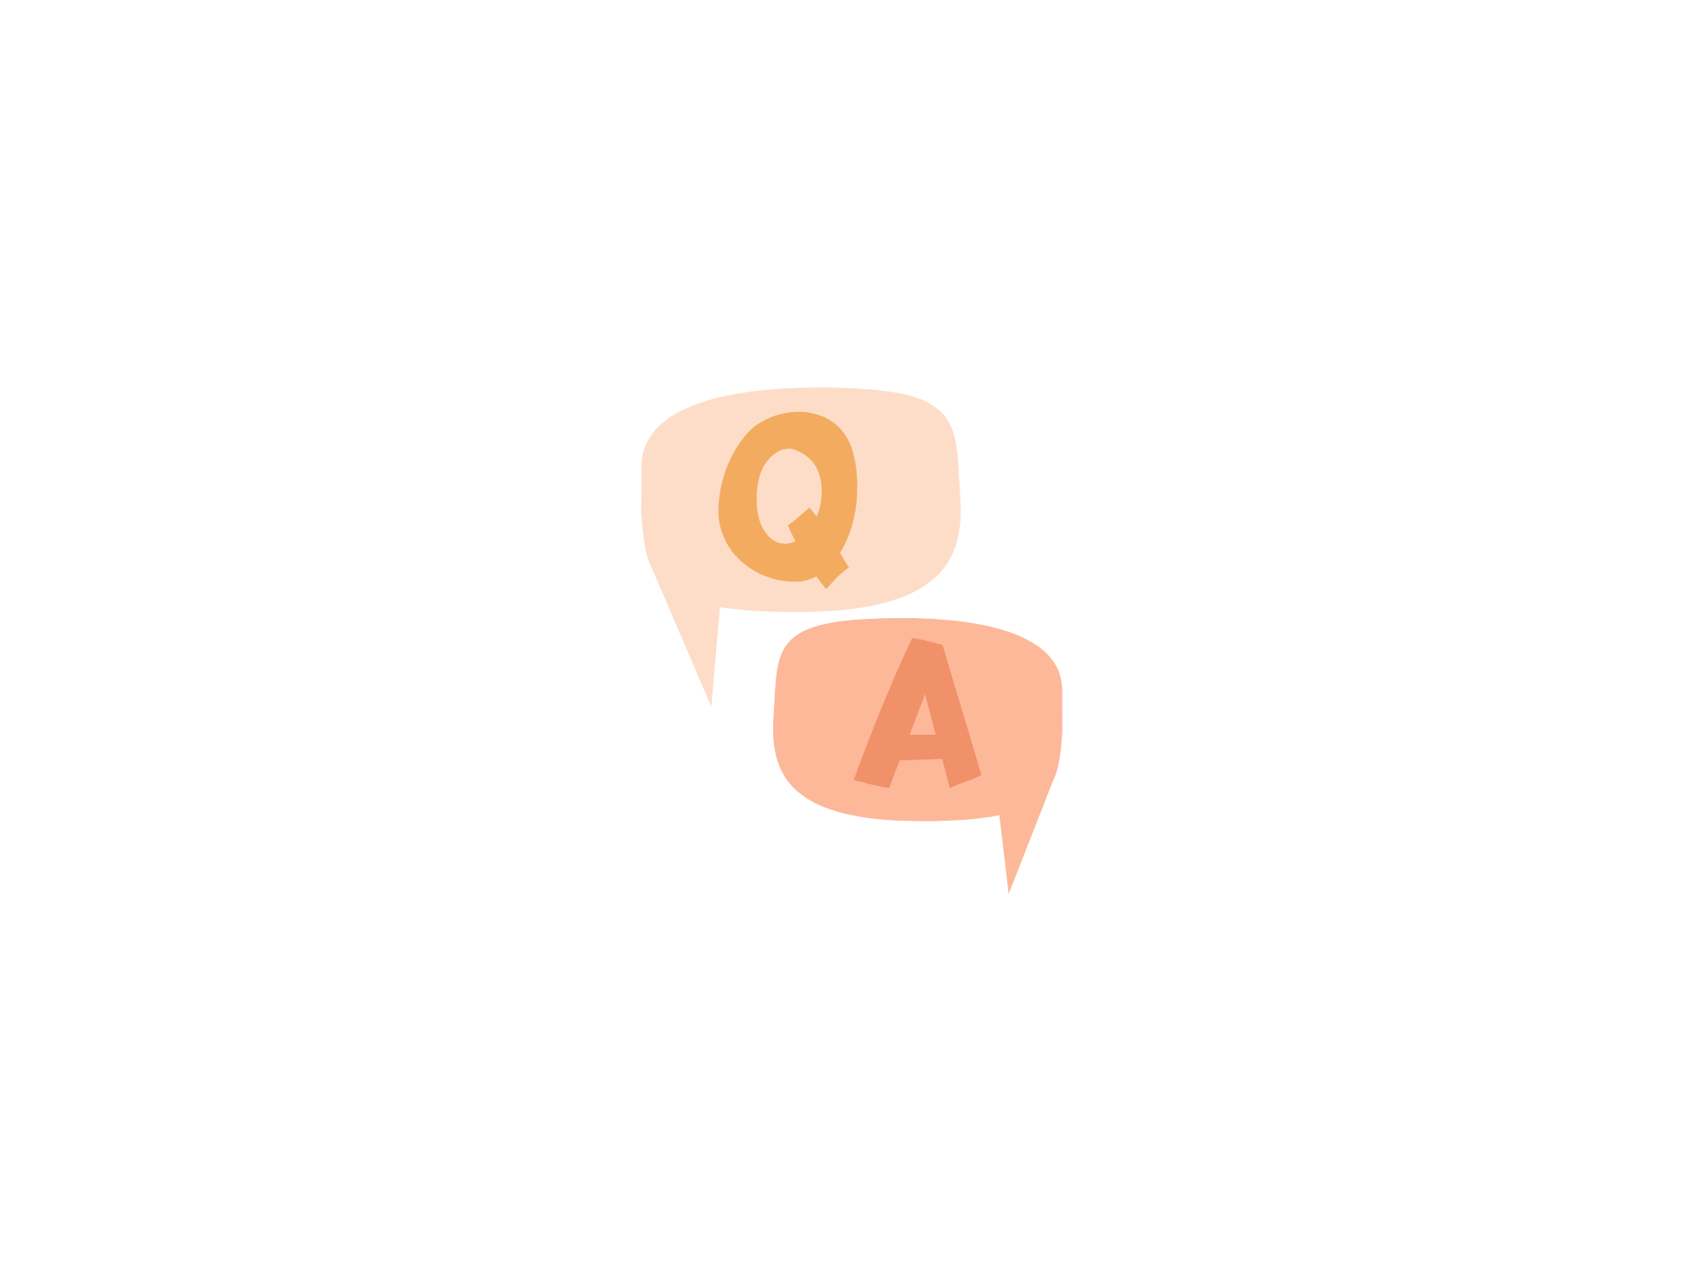
Thank you!
______________________________________
Questions?

Slide 23
References / Resources
References/Resources: Ableism 101: What it is, what it looks like, and what we can do to fix it: https://www.accessliving.org/newsroom/blog/ableism-101/
Words Matter, And It’s Time To Explore The Meaning Of “Ableism.”: https://www.forbes.com/sites/andrewpulrang/2020/10/25/words-matter-and-its-time-to-explore-the-meaning-of-ableism/?sh=4a82fbea7162

